Slide 1


Approximation and Load Shedding for QoS in DSMS*
Carlo Zaniolo
CSD—UCLA
________________________________________ * Notes based on a VLDB’02 tutorial by Minos Garofalakis, Johannes Gehrke, and Rajeev Rastogi

Slide 2
DSMS
Approximation and Load Schedding
DSMS: online response on boundless and bursty data streams—How?
By using approximations and synopses and even
Shedding load when arrival rates become impossible
Approximations and Synopses are often used with normal load too
Shedding is used for bursty streams and overload situations.

Slide 3
Synopses and Approximation
Synopsis: bounded-memory history-approximation
  Succinct summary of old stream tuples
  Examples
    Sliding Windows
    Samples
    Histograms
    Wavelet representation
    Sketching techniques
Approximate Algorithms: e.g., median, quantiles,…
Fast and light Data Mining algorithms

Slide 4
Synopses
Windows: logical, physical (already discussed)
Samples: Answering queries using samples
Histograms: Equi-depth histograms, On-line quantile computation
Wavelets: Haar-wavelet histogram construction & maintenance
Sketches.

Slide 5
Sampling: Basics
Idea: A small random sample S of the data often well-represents all the data
  For a fast approx answer, apply “modified” query to S
  Example: select agg from R where odd(R.e)
  (n=12)
  If agg is avg, return average of odd elements in S
  If agg is count, return average over all elements e in S of
    1 if e is odd
    0 if e is even
Data stream: 9 3 5 2 7 1 6 5 8 4 9 1
Sample S: 9 5 1 8
answer: 5
answer: 3 * 12/4 =9

Slide 6
Sampling—some background
Reservoir Sampling [Vit85]: Maintains a sample S having a pre-assigned size M on a stream of arbitrary size
Concise sampling [GM98]: Duplicates in sample S stored as <value, count> pairs (thus, potentially boosting actual sample size)
Window Sampling [BDM02,BOZ09]. Maintains a sample S having a pre-assigned size M on a window on a stream—reservoir sampling with expiring tuples.
More later …

Slide 7
Probabilistic Guarantees
For all approximation methods we need some probabilistic guarantees:
  Example: Actual answer is within 5 ± 1 with
  prob ≥ 0.9
Use Tail Inequalities to give probabilistic bounds on returned answer
  Markov Inequality
  Chebyshev’s Inequality
  Hoeffding’s Inequality
  Chernoff Bound

Slide 8
Load Shedding & Sampling
Given a complex Query graph how to use/manage the sampling process [BDM04] [LawZ02]
More about this later.

Slide 9
Overview
Windows: logical, physical (covered)
Samples: Answering queries using samples
Histograms: Equi-depth histograms
Wavelets: Haar-wavelet
Sketches

Slide 10
Histograms
Histograms approximate the frequency distribution of element values in a stream
A histogram (typically) consists of
  A partitioning of element domain values into buckets
  A count per bucket B (of the number of elements in B)
Widely used in DBMS query optimization
Many Types of Proposed, e.g.:
Equi-Depth Histograms: select buckets such that counts per bucket are equal
V-Optimal Histograms: select buckets to minimize frequency variance within buckets
Wavelet-based Histograms

Slide 11
Types of Histograms: Equi-Depth Histograms
Equi-Depth Histograms
  Idea: Select buckets such that counts per bucket are equal
Count for
bucket
1 2 3 4 5 6 7 8 9 10 11 12 13 14 15 16 17 18 19 20
Domain values

Slide 12

Types of Histograms: V-Optimal Histograms
V-Optimal Histograms [IP95] [JKM98].
Idea: Select buckets to minimize frequency variance within buckets
Count for
bucket
1 2 3 4 5 6 7 8 9 10 11 12 13 14 15 16 17 18 19 20
Domain values
Minimize:
The histogram consists of J bins or buckets,
n_{j} is the number of items in the jth bin, and
V_{j} is the variance between the values associated with the items in the jth bin.

Slide 13
Equi-Depth Histogram Construction
For histogram with b buckets, compute elements with rank n/b, 2n/b, ..., (b-1)n/b
Example: (n=12, b=4)
Data stream: 9 3 5 2 7 1 6 5 8 4 9 1
After sort: 1 1 2 3 4 5 5 6 7 8 9 9
rank = 3
(.25-quantile)
rank = 9
(.75-quantile)
rank = 6
(.5-quantile)

Slide 14

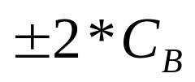
Answering Queries Histograms [IP99]
(Implicitly) map the histogram back to an approximate relation, & apply the query to the approximate relation
Example: select count(*) from R where 4 <= R.e <= 15
For equi-depth histograms, maximum error:
Count spread
evenly among
bucket values
1 2 3 4 5 6 7 8 9 10 11 12 13 14 15 16 17 18 19 20
4 ≤ R.e ≤ 15
answer: 3.5 *

Slide 15
Approximate Algorithms
Quantiles Using Samples
Quantiles from Synopses
One pass algorithms for approximate samples …
Much work in this area … e.g. see [MZ11]

Slide 16
Overview
Windows: logical, physical (covered)
Samples: Answering queries using samples
Histograms: Equi-depth histograms
Wavelets: Haar-wavelet histogram
Sketches

Slide 17
One-Dimensional Haar Wavelets
Wavelets: Mathematical tool for hierarchical decomposition of functions/signals
Haar wavelets: Simplest wavelet basis, easy to understand and implement
  Recursive pairwise averaging and differencing at different resolutions
Resolution Averages Detail Coefficients
3
[2, 2, 0, 2, 3, 5, 4, 4]
----
2
[2, 1, 4, 4]
[0, -1, -1, 0]
1
[1.5, 4]
[0.5, 0]
0
[2.75]
[-1.25]
Haar wavelet decomposition:
[2.75, -1.25, 0.5, 0, 0, -1, -1, 0]

Slide 18
Haar Wavelet Coefficients
Hierarchical decomposition structure (a.k.a. “error tree”)
Coefficient “Supports”
₊
2.75
₋
2.75
₊
+
-1.25
₋
+
-1.25
-
₊
0.5
₋
0.5
0
₊
+
-
+
-
0
₋
0
-1
-1
0
₊
0
₋
+
-
+
-
+
-
+
-
₊
₋
-1
2 2 0 2 3 5 4 4
₊
-1
₋
₊
Original frequency distribution
0

Slide 19
Compressed Wavelet Representations
Key idea: Use a compact subset of Haar/linear wavelet coefficients for approximating frequency distribution
Steps
Compute cumulative frequency distribution C
Compute linear wavelet transform of C
Greedy heuristic methods
  Retain coefficients leading to large error reduction
  Throw away coefficients that give small increase in error

Slide 20
Overview
Windows: logical, physical (covered)
Samples: Answering queries using samples
Histograms: Equi-depth histograms, On-line quantile computation
Wavelets: Haar-wavelet histogram construction & maintenance
Sketches

Slide 21
Sketches
Conventional data summaries fall short:
  Hard to count distinct items by sampling: infrequent ones will be missed
  Samples (e.g., using Reservoir Sampling) perform poorly for joins
  Multi-d histograms/wavelets: Construction requires multiple passes over the data
Different approach: Randomized sketch synopses
  Only logarithmic space
  Probabilistic guarantees on the quality of the approximate answer
  Can handle extreme cases.

Slide 22
Synopses structures: sketches
Sketch
  Synopsis structure taking advantage of high volumes of data
  Provides an approximate result with probabilistic bounds
  Random projections on smaller spaces (hash functions)
Many sketch structures: usually dedicated to a specialized task

Slide 23
Synopses structures: sketches
E.g. A Hash-based method: COUNT (Flajolet 85)
Goal
  Number N of distinct values in a stream (for large N)
  Ex. number of distinct IP addresses going through a router
Sketch structure
  SK: L bits initialized to 0
  H: hashing function transforming an element of the stream
  into L bits
  H distributes uniformly elements of the stream on the 2^{L} possibilities
0 | 0 | 0 | 0 | 0 | 0 | 0 | 0
18.6.7.1
0 | 0 | 1 | 0 | 1 | 0 | 1 | 0

Slide 24
Synopses structures: a count-distinct method
Method
  Maintenance and update of SK
    For each new element e
    Compute H(e)
    Select the position of the rightmost 1 in H(e)
    But then remember the leftmost 1 position among the samples
SK
0 | 1 | 0 | 0 | 1 | 0 | 0 | 1
H(18.6.7.1)
0 | 0 | 1 | 0 | 1 | 0 | 1 | 0
New SK
0 | 1 | 1 | 0 | 1 | 0 | 0 | 1

Slide 25
A count-distinct method
Result
  Select the position R (0…L-1) of the leftmost 0 in SK
  E(R) = log₂ (φ*N) with φ = 0.77351…
  σ(R) = 1.12
SK
1 | 1 | 1 | 0 | 1 | 0 | 0 | 0
  For n elements already seen, we expect:
    SK[0] is forced to 1 N/2 times
    SK[1] is forced to 1 N/4 times
    SK[k] is forced to 1 N/2^{k+1} times
R?
Notes:
Proba(SK(0)=1= n/2
Proba(SK

Slide 26
Linear-Projection Sketches (a.k.a. AMS)

Slide 27
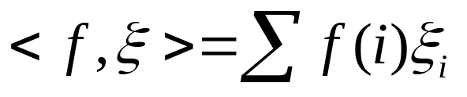


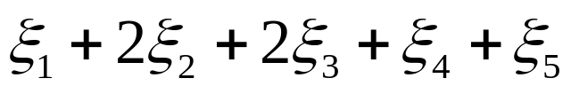
Linear-Projection Sketches (a.k.a. AMS)
Goal: Build small-space summary for distribution vector f(i) (i=1,..., N) seen as a stream of i-values
Basic Construct: Randomized Linear Projection of f() = project onto inner/dot product of f-vector
  Simple to compute over the stream: Add whenever the i-th value is seen
  Tunable probabilistic guarantees on approximation error
2
2
1
1
1
Data stream: 3, 1, 2, 4, 2, 3, 5, . . .
f(1) f(2) f(3) f(4) f(5)
where = vector of random values from an appropriate distribution
Data stream: 3, 1, 2, 4, 2, 3, 5, . . .

Slide 28


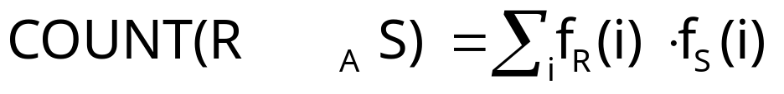
Estimitating Size of Binary-Joins
Problem: Compute answer for the query COUNT(R _{A} S)
Example:
3
2
Data stream R.A: 4 1 2 4 1 4
1
0
1
2
3
4
2
2
Data stream S.A: 3 1 2 4 2 4
1
1
1
2
3
4
= 10 (2 + 2 + 0 + 6)
Exact solution: too expensive, requires O(N) space!
  N = sizeof(domain(A))

Slide 29




Basic AMS Sketching Technique [AMS96]
Key Intuition: Use randomized linear projections of f() to define random variable X such that
  X is easily computed over the stream (in small space)
  E[X] = COUNT(R _{A} S)
  Var[X] is small
Basic Idea:
  Define a family of 4-wise independent {-1, +1} random variables
  Pr[ = +1] = Pr[ = -1] = 1/2
    Expected value of each , E[ ] = 0
  Variables are 4-wise independent
    Expected value of product of 4 distinct = 0
  Variables can be generated using pseudo-random generator using only O(log N) space (for seeding)!
Probabilistic error guarantees
(e.g., actual answer is 10±1 with
probability 0.9)

Slide 30
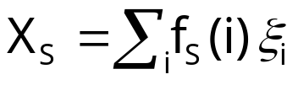
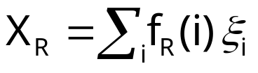




AMS Sketch Construction
X = X_{R}X_{S} to be estimate of COUNT query
Compute random variables: and
  Simply add to X_{R} whenever the i-th value is observed in the R.A stream
Example:
3
2
Data stream R.A: 4 1 2 4 1 4
1
0
1
2
3
4
2
2
Data stream S.A: 3 1 2 4 2 4
1
1
1
2
3
4

Slide 31
Sketches Applications
Because of the four-wise independence the product X_{R}X_{S} the is an unbiased estimate of the correct count of those natural joins.
  Thus it can be used for semantic load shedding
In practice: accuracy can be improved by multiple runs of the process and then taking the average, and finally the median of averages.
Many special-purpose sketch techniques have been proposed for different applications.
  Here we have seen (i) estimating IP addresses and (ii) size of equi-joins.

Slide 32
Dropping Tuples (for load shedding)
Random load shedding: tuples are dropped without paying attention to actual tuple values
Semantic Load Shedding: based on tuple values
  Some tuples values are more important to the
  utility (more useful) than some others
  Example: Window Joins on streams. A one hour window on each stream. What do we do when there is insufficient memory to keep the entire state in order to provide the exact result of sliding window join?

Slide 33
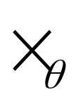
Load Shedding for Window Joins for Multiple Data Streams
Compute continuous sliding-window joins between r streams S₁, …, S_{r} with window W₁,…,W_{r}.
Memory M
W₁
S₁
…..
Output
S_{r}
W_{r}
Join operator
1. A simple solution is to drop the older tuples,
2. Another is to drop tuples with least productivity—which can be estimated by sketches.

Slide 34
Which Tuples should be Dropped?
Depending on the objectives:
  Max-subset of the joined result
  Generate a result that is an unbiased sample the actual join result
    This is what is needed estimate aggregates
Dropping tuples at random accomplish neither objective
But sketches can be very effective.

Slide 35
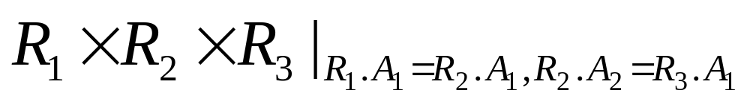
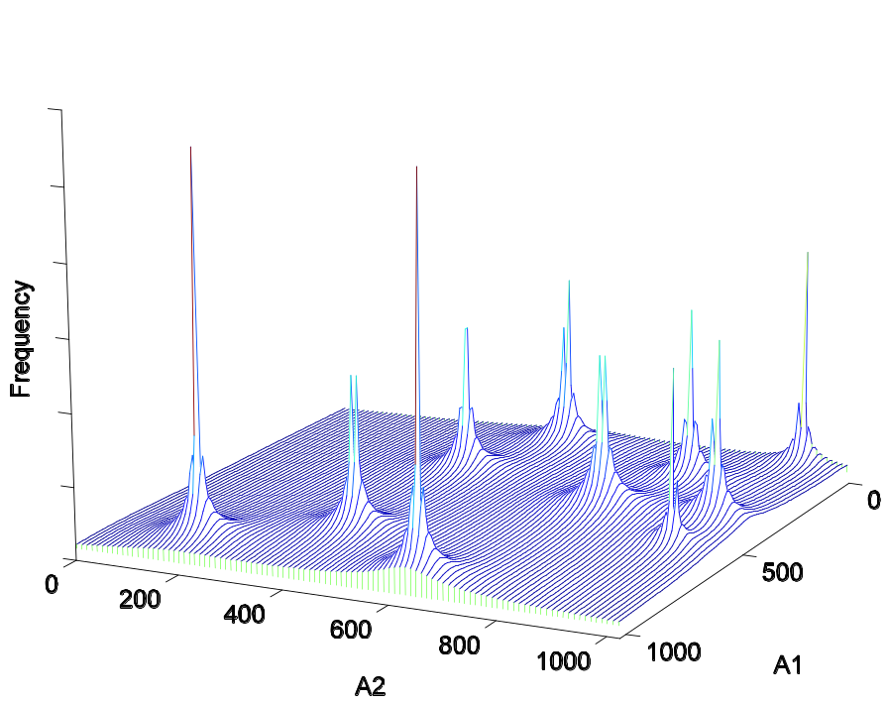
Three-Relation Joins Experiments [LawZ06]
Query:
Synthetic Data Sets:
  10 dense regions with
  different zipfian factors
Data Distribution:
  Several techniques tested

Slide 36
Experiments and Results
Rand: random drop--worst
MSketch: drop lowest productivity tuples estimated using sketeches on mutijoins (best for maxsubset)
BJoin: converting to a multi-binary join—2nd best
Aging: drop the oldest tuple ‡
MSketch*Aging: scaling the priority by its remaining lifetime. ‡
MSketch_RS: drop tuples with largest fraction already produced (good for random sampling)
‡ Poor performance: This shows that remaining lifetime is not important in optimizing load shedding for max subset

Slide 37
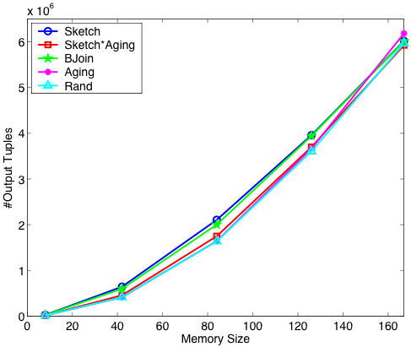

Slide 38
References—sketches, Histograms,Quantiles
[AMS96] Alon,, Matias, Szegedy. “The space complexity of approximating the frequency ments”, ACM STOC’1996.
[AGM99] N. Alon, P.B. Gibbons, Y. Matias, M. Szegedy. Tracking Join and Self-Join Sizes in Limited Storage. ACM PODS, 1999.
[CMN98] S. Chaudhuri, R. Motwani, and V. Narasayya. “Random Sampling for Histogram Construction: How much is enough?”. ACM SIGMOD 1998.
[DGG02] A. Dobra, M. Garofalakis, J. Gehrke, R. Rastogi. Processing Complex Aggregate Queries over Data Streams. ACM SIGMOD, 2002.
[FM85] P. Flajolet, G.N. Martin. “Probabilistic Counting Algorithms for Data Base Applications”. JCSS 31(2), 1985.
[Gang07] Sumit Ganguly: Counting distinct items over update streams. Theor. Comput. Sci. 378(3): 211-222 (2007)
[GGI02] A.C. Gilbert, S. Guha, P. Indyk, Y. Kotidis, S. Muthukrishnan, M. Strauss. Fast, small-space algorithms for approximate histogram maintenance. ACM STOC, 2002.
[GK01] M. Greenwald and S. Khanna. “Space-Efficient Online Computation of Quantile Summaries”. ACM SIGMOD 2001.
[GKM01] A.C. Gilbert, Y. Kotidis, S. Muthukrishnan, M. Strauss. Surfing Wavelets on Streams: One Pass Summaries for Approximate Aggregate Queries. VLDB 2001.
[GKM02] A.C. Gilbert, Y. Kotidis, S. Muthukrishnan, M. Strauss. “How to Summarize the Universe: Dynamic Maintenance of Quantiles”. VLDB 2002.
[GKS01b] S. Guha, N. Koudas, and K. Shim. “Data Streams and Histograms”. ACM STOC 2001.
[GMP97] P. B. Gibbons, Y. Matias, and V. Poosala. “Fast Incremental Maintenance of Approximate Histograms”. VLDB 1997.

Slide 39
References—sketches, Histograms …(cont.)
[IKM00] P. Indyk, N. Koudas, S. Muthukrishnan. Identifying representative trends in massive time series data sets using sketches. VLDB, 2000.
[IP99] Y.E. Ioannidis and V. Poosala. “Histogram-Based Approximation of Set-Valued Query Answers”. VLDB 1999.
[JKM98] H. V. Jagadish, N. Koudas, S. Muthukrishnan, V. Poosala, K. Sevcik, and T. Suel. “Optimal Histograms with Quality Guarantees”. VLDB 1998.
[MRL98] G.S. Manku, S. Rajagopalan, and B. G. Lindsay. “Approximate Medians and other Quantiles in One Pass and with Limited Memory”. ACM SIGMOD 1998.
[MRL99] G.S. Manku, S. Rajagopalan, B.G. Lindsay. Random Sampling Techniques for Space Efficient Online Computation of Order Statistics of Large Datasets. ACM SIGMOD, 1999.
[MVW00] Y. Matias, J.S. Vitter, and M. Wang. “Dynamic Maintenance of Wavelet-based Histograms”. VLDB 2000.
[LawZ06] Yan-Nei Law, Carlo Zaniolo: Load Shedding for Window Joins on Multiple Data Streams. ICDE Workshops 2007: 674-683
[PIH96] V. Poosala, Y. Ioannidis, P. Haas, and E. Shekita. “Improved Histograms for Selectivity Estimation of Range Predicates”. ACM SIGMOD 1996.
[PSC84] G. Piatetsky-Shapiro and C. Connell. “Accurate Estimation of the Number of Tuples Satisfying a Condition”. ACM SIGMOD 1984.
[TGI02] N. Thaper, S. Guha, P. Indyk, N. Koudas. Dynamic Multidimensional Histograms. ACM SIGMOD, 2002.
[MZ11]Hamid Mousavi, Carlo Zaniolo: Fast and accurate computation of equi-depth histograms over data streams. EDBT/ICDT '11

